Slide 1

REZY
Title –Online Cafe Food Booking System
Team Leader - Vishal Chaturvedi(240029140246)
Vanshika Garg(240029140233)
Simran Tyagi(240029140206)
Shefali Yadav(240029140193)
Project Supervisor:
Ms. Anita Yadav
Ms. Shruti Aggarwal
Mr. Amit Kumar Gupta
Assistant Professor

Slide 2
The Future Bifurcation of CA 1 Marks is as Follows
Parameters | Marks
Problem Statement & Domain Understanding | 13
Defined Objectives, Scope & Expected Outcomes | 15
Methodology Selection (Tech Stack, models ,tools ) and Initial Implementation Progress(UI/Architecture) | 10
Research Outcomes (Innovation/Research Publications / Patent) | 10
Presentation Clarity & Quality | 10
Total | 60

Slide 3
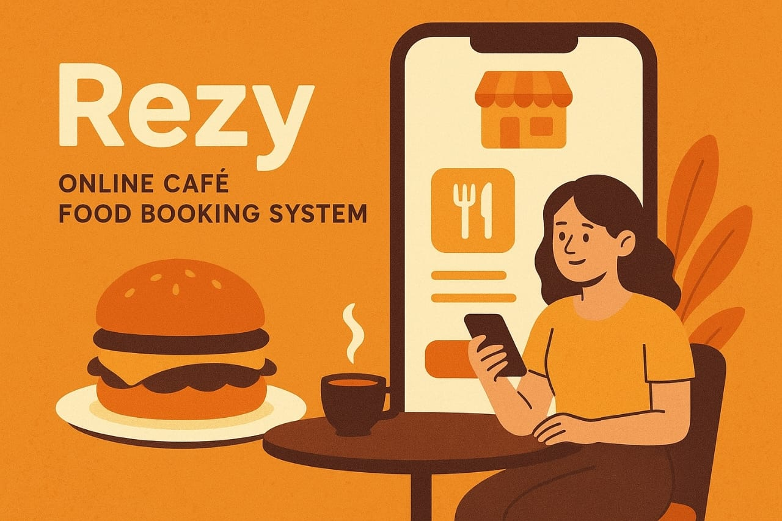
Project Title “Smart Food Pre-Ordering & Table Booking System” “Skip the wait. Pick up or dine hassle-free.”
REZY

Slide 4
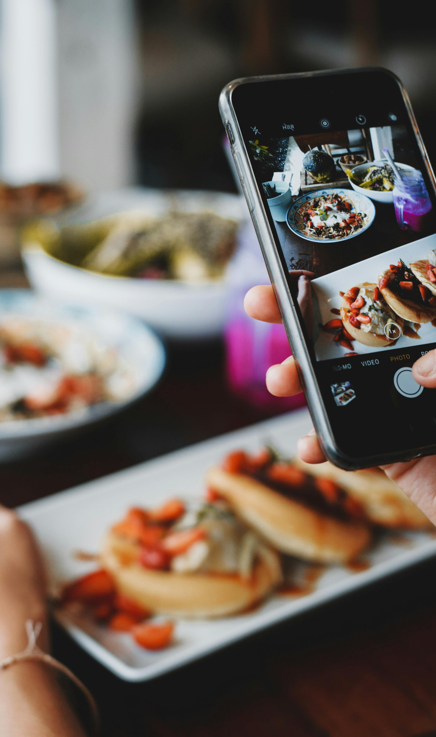
Introduction
Online Café Food Booking System is a web app that lets customers browse menus, place and track orders, while café staff manage them efficiently. It minimizes errors, reduces wait times, and enhances satisfaction using Flask, MySQL, and Docker.

Slide 5

Problem Statement & Domain Understanding
Customers waste time waiting in cafes/restaurants.
Peak hours lead to long queues & delayed service.
Book a table in advance.
Cafe prepares food as per time slot.

Slide 6
Project Objectives
Develop a user-friendly online ordering & (optional) reservation platform.
1
Allow customers to pre-order food with a time slot.
2
Ensure scalability and portability via Dockerized deployment.
4
Deliver transparent pricing, order tracking, and digital receipts.
Ensure cafe prepares food on time to avoid waiting.
3

Slide 7
Scope & Project Outcomes
Streamlined ordering and reduced wait times enhance customer experience.
Automated order logging, billing, and status tracking reduces human errors.
Scalable, secure architecture suitable for cafés of any size.
Improved café service efficiency.
Enhanced customer satisfaction.

Slide 8
Tools and Technologies
Backend: Python (Flask)
Frontend: HTML5, CSS3, JavaScript
Database: MySQL
Development: VS Code, Git/GitHub
Deployment: Docker & Docker Compose
Testing: PyTest / Unittest

Slide 9
Initial Implementation Progress
UI Pages Created
Homepage → café intro, featured menu items.
Menu Page → list of food items with “Add to Cart” option.
Cart & Checkout Page → selected items, quantity, bill amount & time slot.
Table Booking Page → date & time slot selection.
Login & Signup Pages → user authentication.

Slide 10
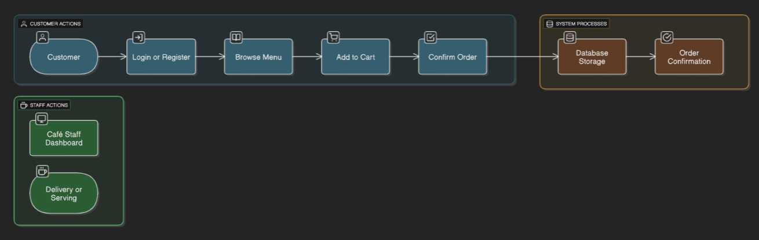
Data Flow Diagram

Slide 11
Generate Reports/
And invoice
Admin
Receipt/ invoice
Reports
daily/monthly/ annually transaction
Transactions
Customer
D2 Transactions
View History
Access app on
Order information
Transactions
Finished order
Tablet/phone
/laptop
Rezy
Pick up confirmation
Process Orders
Cafe
Verified orders
Place order on
Access Orders
place Orders
Verify Orders
All Orders
View menu
Order verified
Accessed orders
Orders need to access in the database
D1 Product
Product information
Verified product information

Slide 12
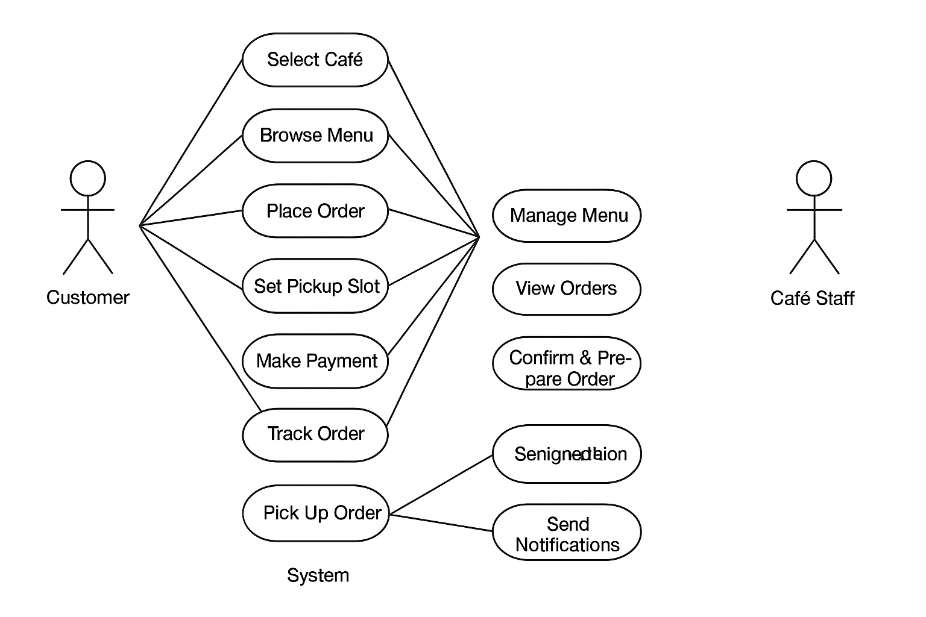
Use Case Diagram

Slide 13
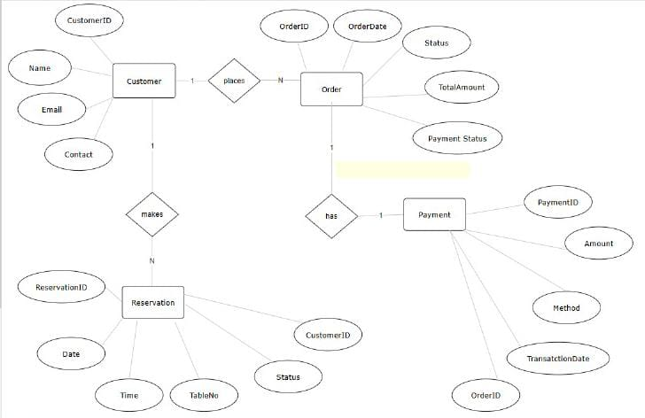
ER DIAGRAM Diagram

Slide 14
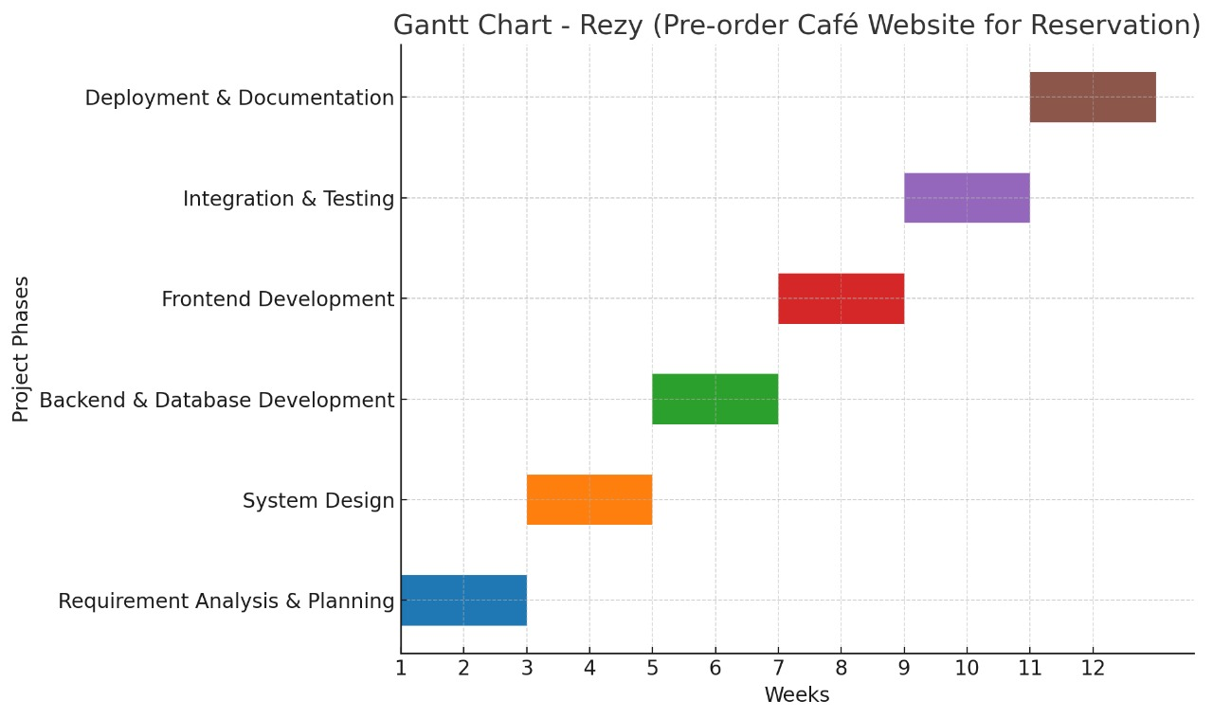
Gantt Chart (Agile Methodology)

Slide 15

Future Enhancements
Online payments with reconciliation and refunds.
AI-driven recommendations and dynamic combos; chatbot ordering.
Rewards, coupons, and referrals.
Multiple cafe handling.
Table reservations and order scheduling; multi-branch support.

Slide 16

Conclusion
Reduced manual errors and waiting time through a digital platform.
Real-time order tracking and user-friendly interface improved satisfaction.
Simplified menu updates, order management, and operational control for café staff.
Built with Flask, MySQL, and Docker to support future upgrades like online payments and AI-based recommendations.

Slide 17
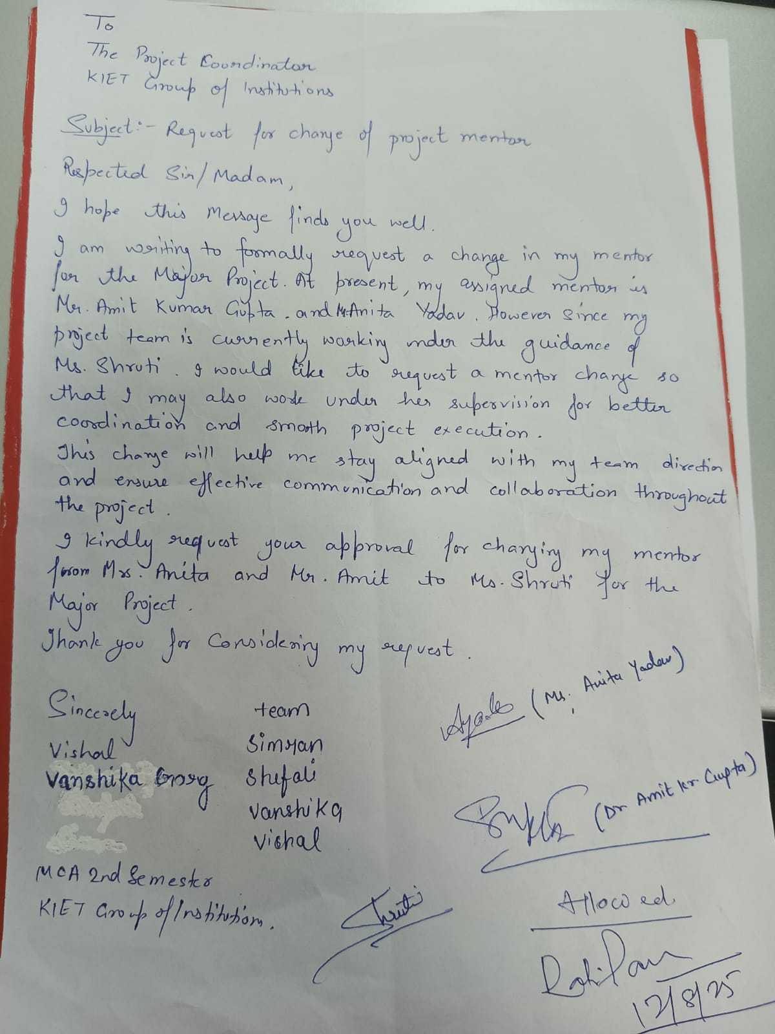
Consent Letter

Slide 18
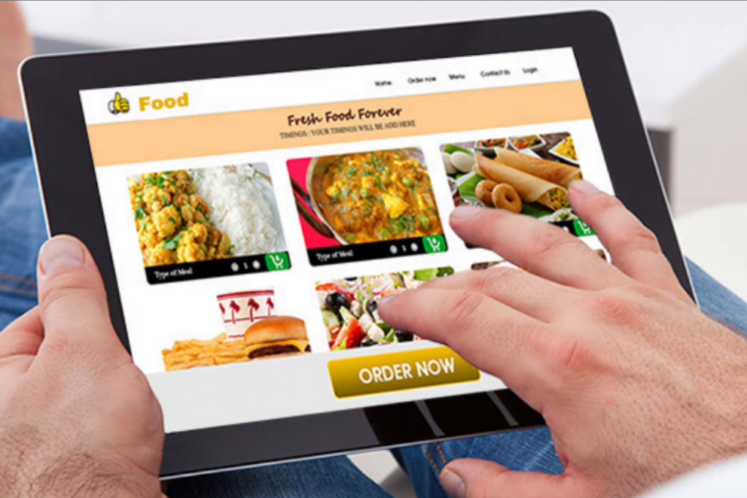
ThankYou

